Slide 1
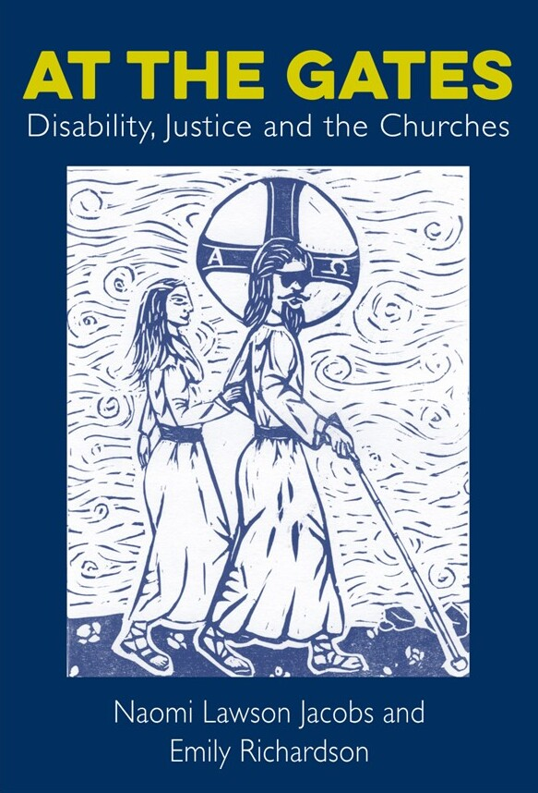
Exploring Difference: Disabled People’s Stories about Ourselves and God

Slide 2
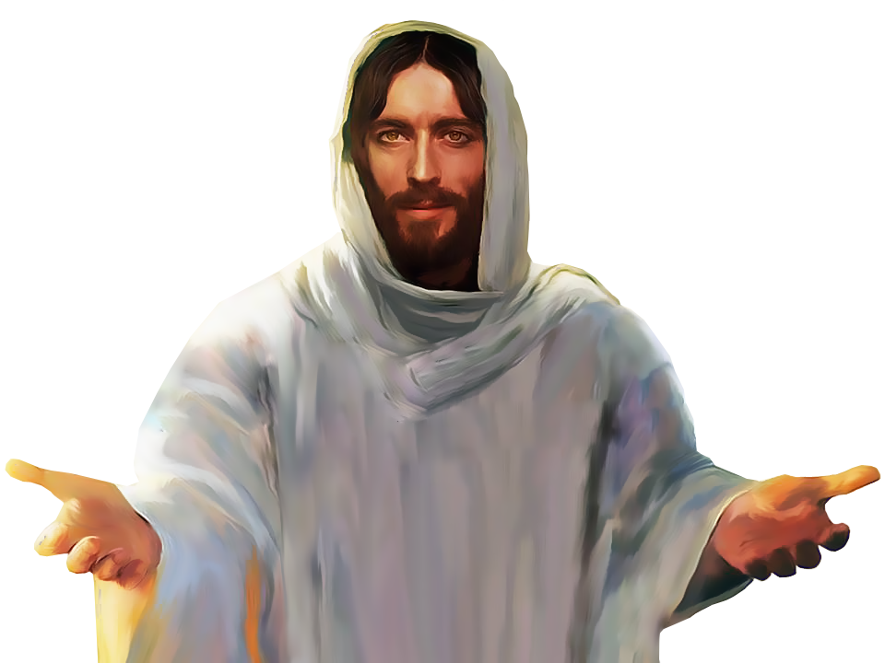
What is the first depiction of Jesus you remember? What was this Jesus like?
To Discuss
(for 3 minutes)

Slide 3
Disabled Christ images
By Dr Rachel Holdforth

Slide 4
The Deaf Christ

Slide 5
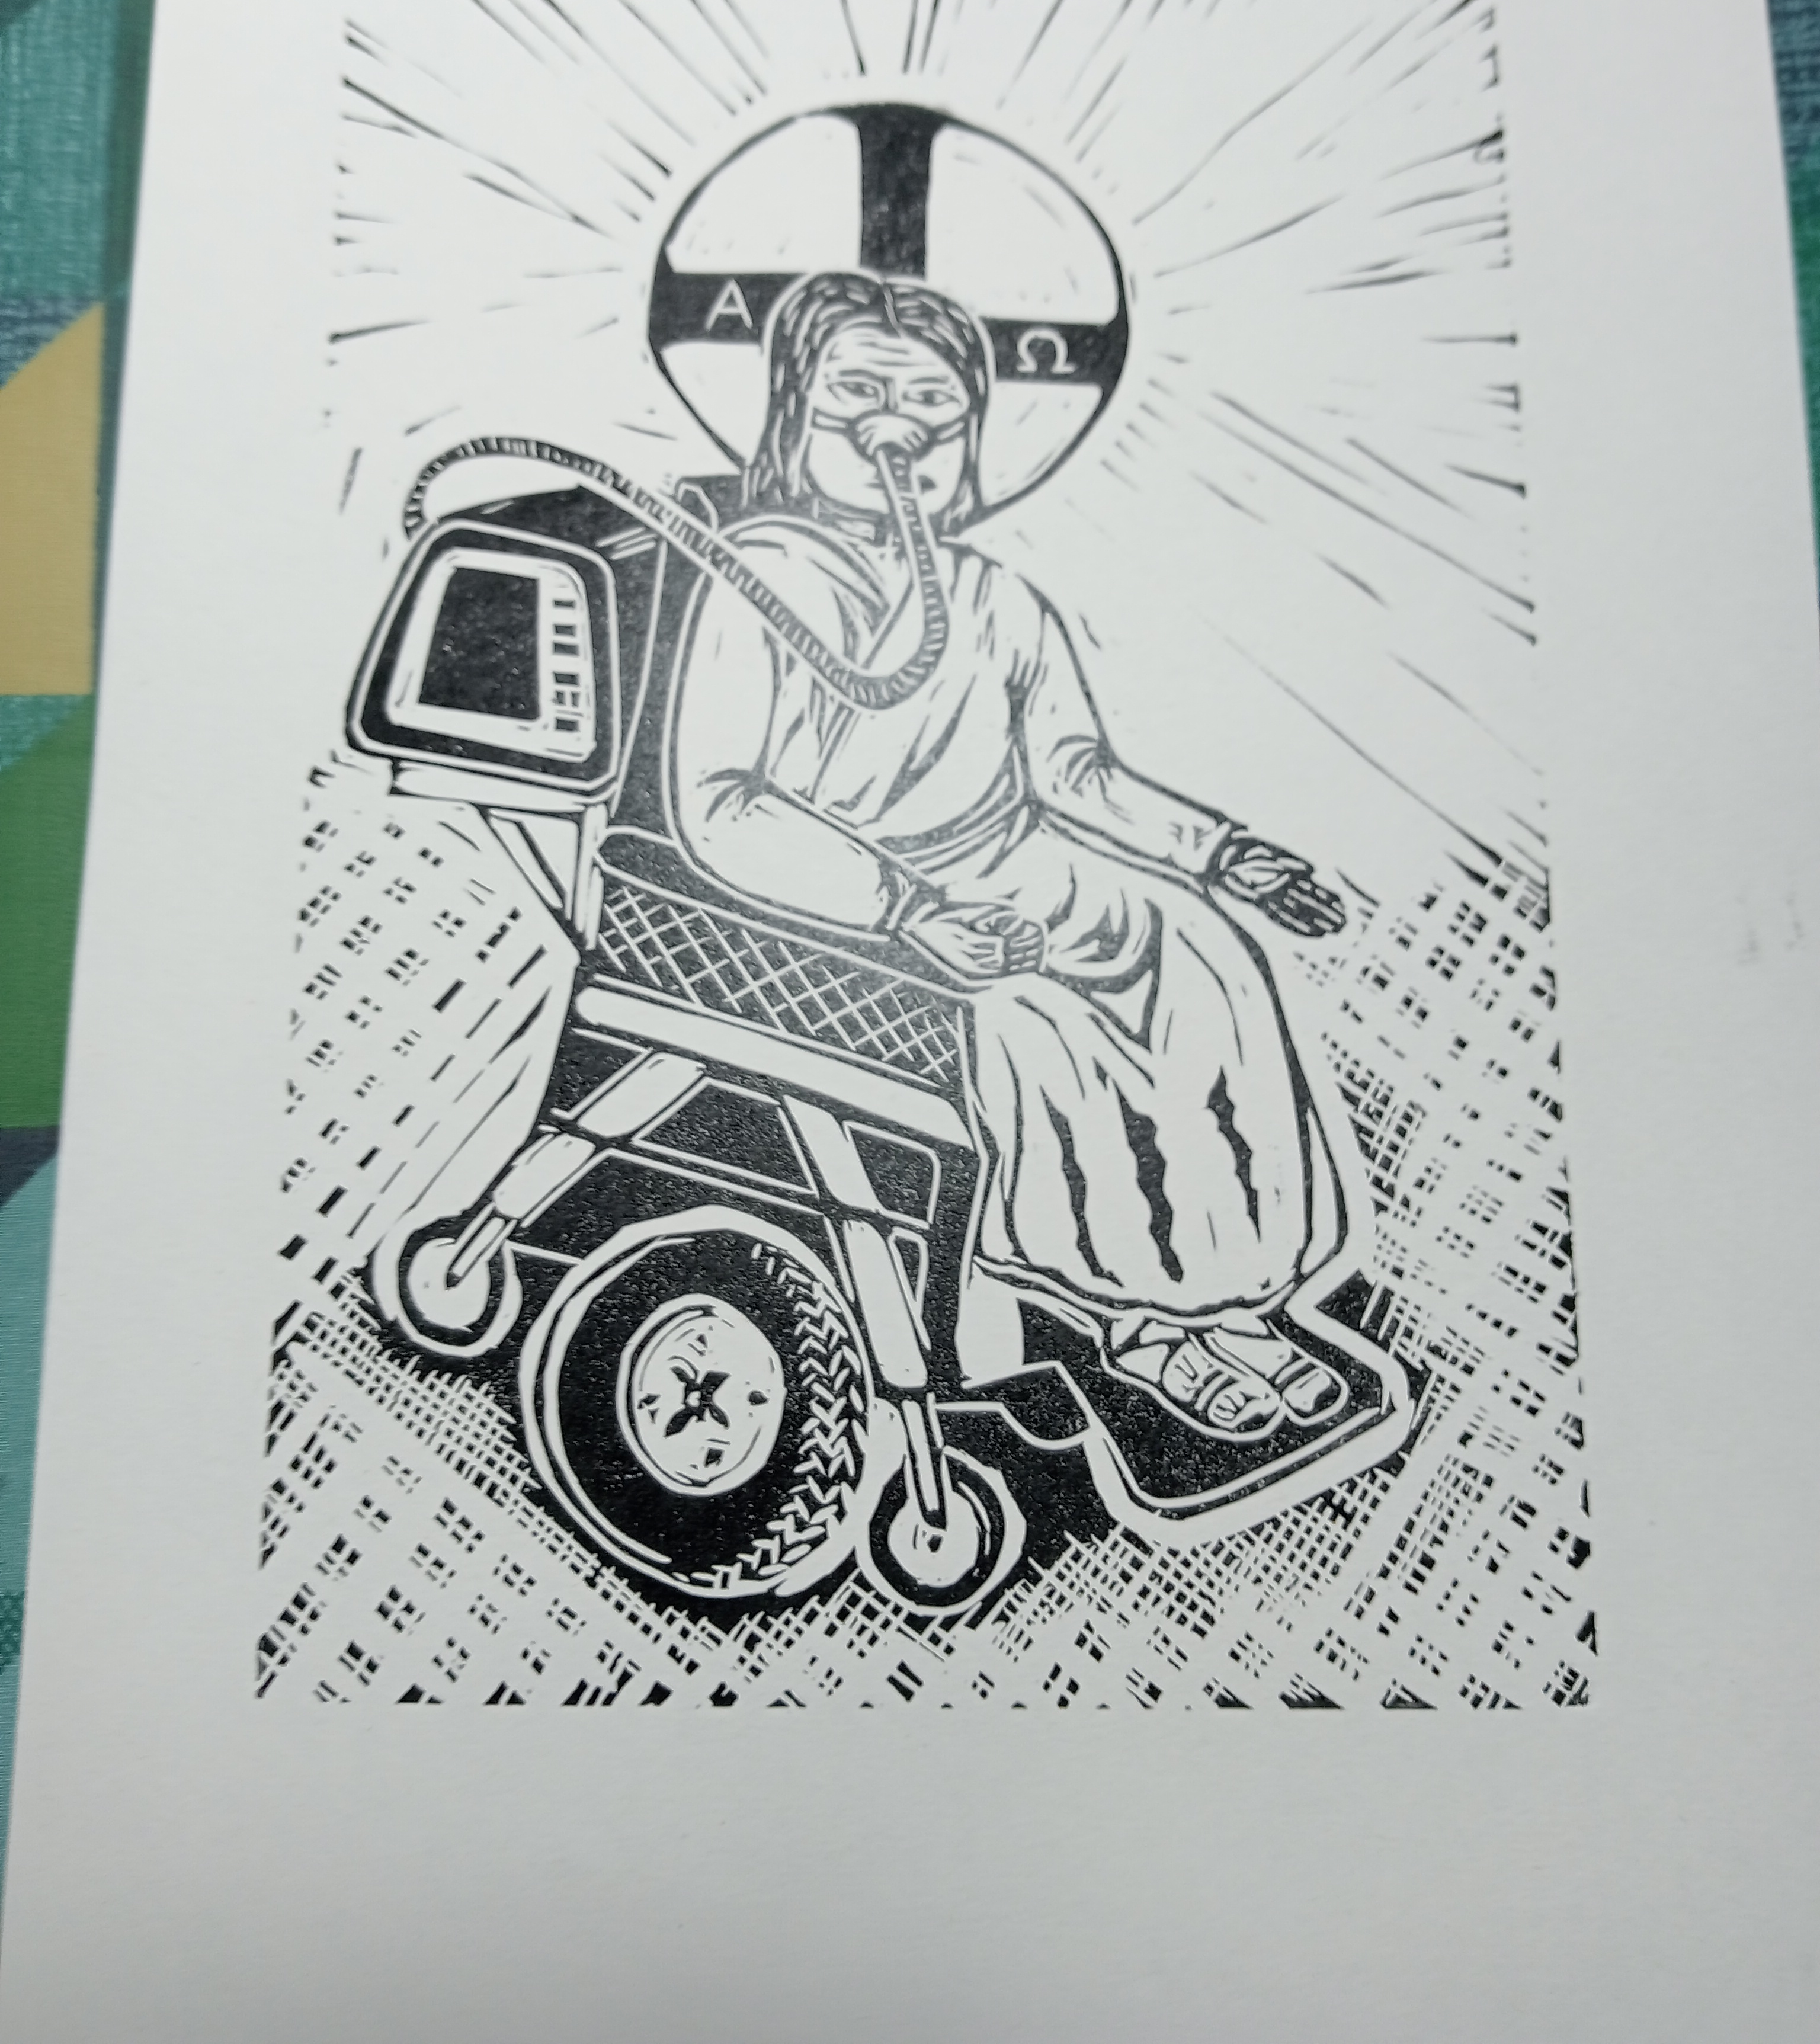
The Wheelchair-User Christ

Slide 6
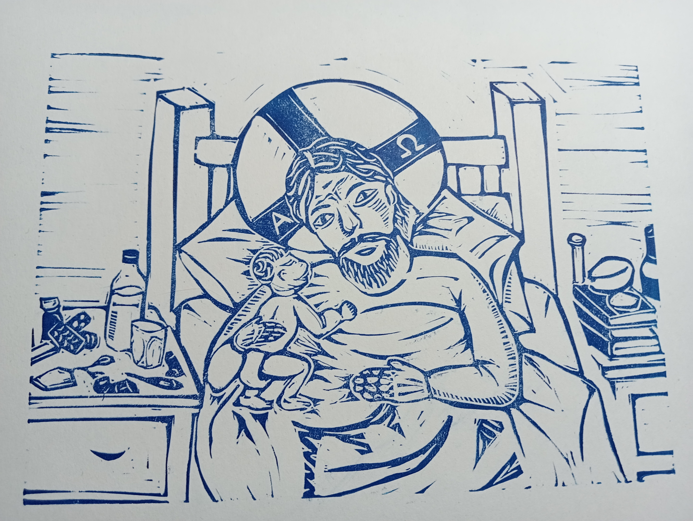
The Chronically Ill Christ

Slide 7
A Perfect Jesus… or a Disabled Jesus?
How do you feel about the images of a disabled Christ?
If you find them surprising, why is that?
Why might it be important for us to imagine God differently from the expected ways?
A disabled God challenges our culture’s “hallucination of wholeness.”
Sharon V. Betcher, Spirit & the Politics of Disability (2007)
A disabled God shows us “that full personhood is fully compatible with the experience of disability.”
Nancy L. Eiesland, The Disabled God (1994)
Notes:
Jesus lived under very social different circumstances from us – would have had no access to modern healthcare
By his 30s, Jesus would probably have been missing some teeth and may have had major injuries as a carpenter (his disciples the fishermen almost certainly did)
He lived under occupation – the Roman Empire was not kind to Jewish people – what impact did that trauma have on his mental health? Did he develop a chronic physical condition?
These are things we don’t imagine. We imagine Jesus as physically perfect, based on our own standards of perfection – and maybe that limits our imagination of the incarnation

Slide 8
Black Christ by Ronald Harrison

Slide 9
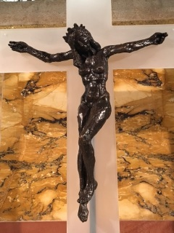
Christa by Edwina Sandys

Slide 10
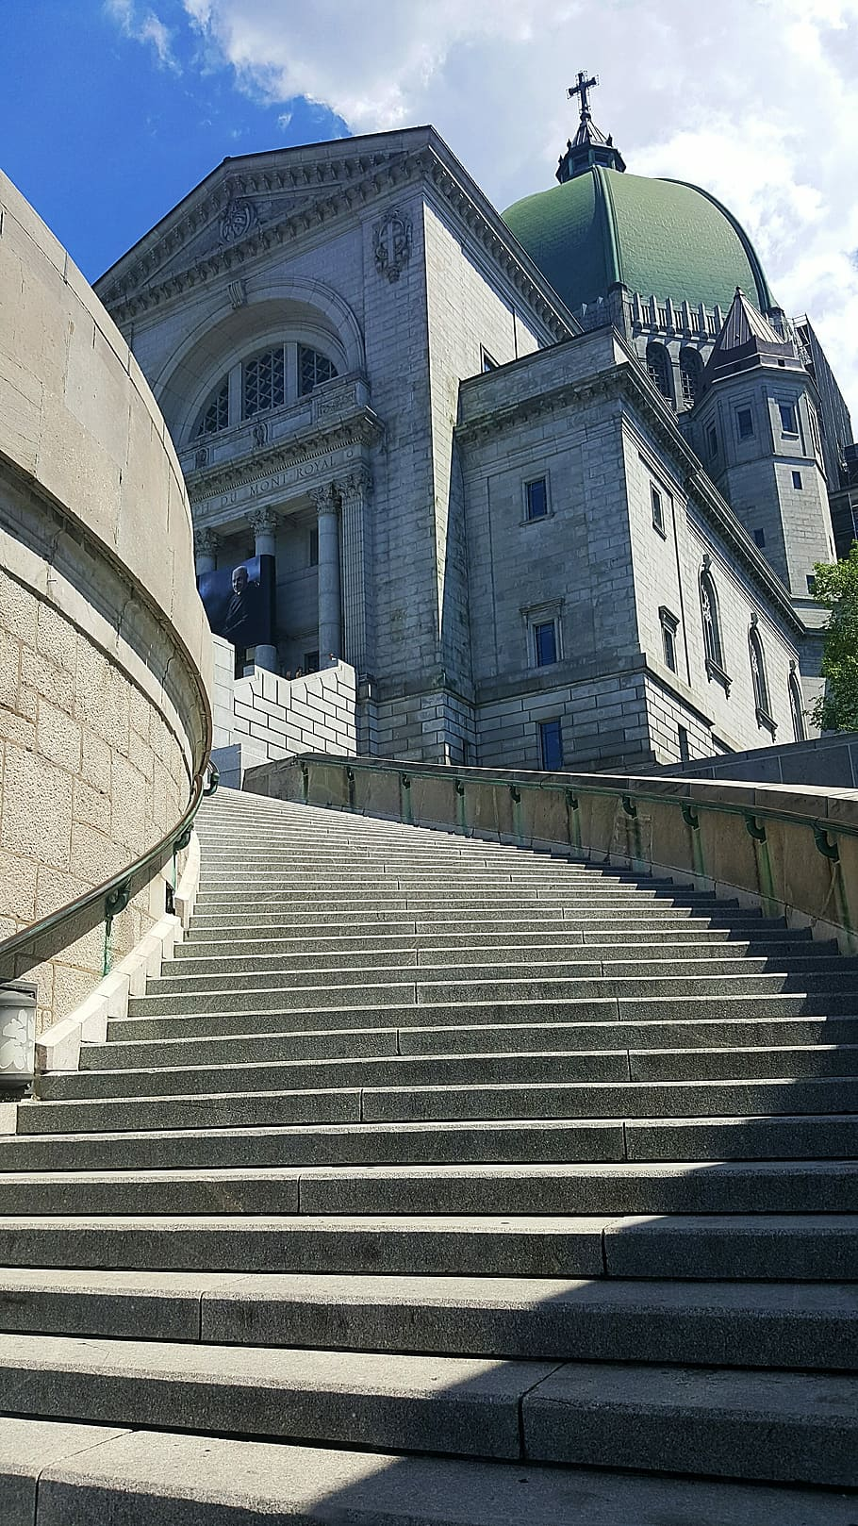
“For many disabled people the church has been a city on a hill – physically inaccessible and socially inhospitable.” - Nancy L. Eiesland
Key Concept: Ableism
A social system that privileges an imagined idea of the ‘normal’ body-mind and views disabled people as inferior and lacking.

Slide 11
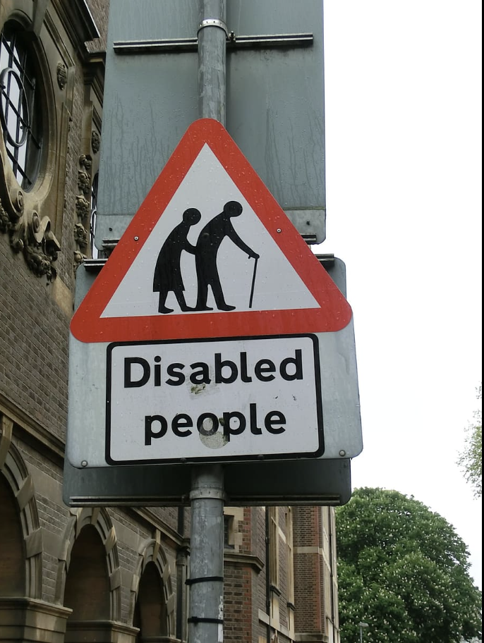
“So much of the time the voices heard on disability – particularly in the church – are non-disabled people who speak from study or research or observation or living alongside someone... it is from the centre looking out, rather than from the edge… If it is the only voice, it can do damage.” - Fiona MacMillan & Samuel Wells, 2021
Telling our own stories about faith & God
In society’s debates about disability, who should get to speak?

Slide 12
How Theology Affects Disabled People
Imagine that for many years, you have had a chronic illness that causes pain and fatigue. At church, fellow Christians say you just need to have more faith. They say that you will be healed if you confess your sin.
How might this make you feel about yourself? Write 3 words.
“I felt reduced to an object of pity, charity, and only worth something if I was physically healed… It made me feel, in all honesty, less than human.” - Fern
“Healing is being made whole, with the disability/condition… coming to see yourself as whole. Curing, to me, implies removal of the disability to make someone ‘better’… God made me like this, and therefore there is nothing wrong with me. Granted, pain and disability are often unpleasant, but what makes them so difficult is the lack of support and understanding.” - Jane

Slide 13
Disabled People’s Stories
Ableism and barriers in churches
How preaching (stories) about disability affects them
How they think about healing and wholeness
Stories about God: God with us – God like us – God for us
The importance of listening to disabled people
The disabled people in At the Gates told their own stories about God, faith and churches.
These were very different stories from most disability theology.
Book recommendation:
Miranda Fricker, Epistemic Injustice: Power and the Ethics of Knowing (2009)
Notes:
Disabled People’s Stories
The disabled storytellers in ‘At the Gates’ told us their own stories about disability, faith and God. They told us about:
What needs to change for them to participate in churches
The impact of churches’ preaching and teaching on disability
God’s Kingdom healing
Different ways of thinking about God [I’LL COME BACK TO THOSE IN A MINUTE]: a God who is with us (in lament and suffering and joy) – a God who is like us (a disabled God) – and a God who is for us (a God of justice, who cares about what happens to marginalized & oppressed people)
Disability & justice
Disabled people’s leadership – Emily will talk more later about disabled people’s leadership in online church groups – and many people asked for their leadership potential to be recognized by the church
The importance of listening to disabled people.
These are theologies from lived experience. They’re prophetic calls for justice, challenging ableism in churches and society, and calling for church gates to be opened – physically and metaphorically – so that everyone can come in and participate.

Slide 14
A God Like Us
…a disabled God
“Jesus was disabled too, after the crucifixion. I can’t quite believe I’ve never noticed that. Even though we’re explicitly told about how after the resurrection he had wounds, etc. But we don’t discuss that side of it ever, which is weird as it’s right there. Maybe [the story is] not just the nice fairy-tale version.” - Fern
Notes:
God Like Us
And then there were ideas about a God who is like us – a disabled God. Some storytellers had deep experiences of identifying with the incarnation, and the idea that Jesus probably did not have a perfect body because no human being does and he was a fully human – so he would have experienced pain and fatigue and physical variations – something that many disabled people know about.
And some storytellers remembered that Jesus was resurrected with his scars, his wounds. His resurrection body was disabled. And it was perfect.
So Fern s §aid, “Jesus was disabled too, after the crucifixion. I can’t quite believe I’ve never noticed that. Even though we’re explicitly told about how after the resurrection he had wounds, etc. But we don’t discuss that side of it ever, which is weird as it’s right there. Maybe [the story is] not just the nice fairy-tale version.”

Slide 15
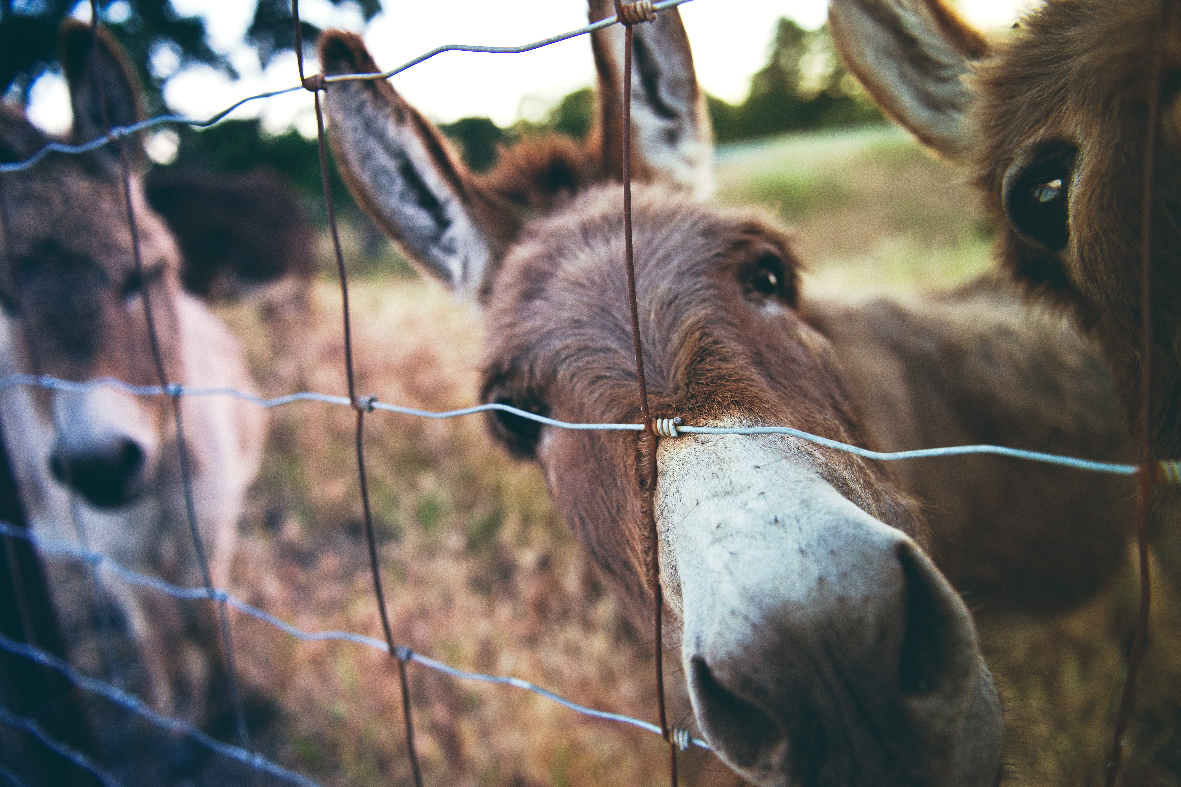
God For Us: A God of Justice
“If Jesus was here I don’t think he would be going along with what the privileged did. I think he would be interested in people who are on the margins of society.”
- Andrew
“Jesus, our King, rode on a ridiculous unbroken donkey. He looked like a fool. And that’s our model of power.”
- Zoe
Notes:
God For Us: A God of Justice
Other storytellers spoke from experiences of injustice, and they reminded the church that Jesus had a mission to people on the margins FIRST. So Zoe challenged power in churches: “The Kingdom of God is meant to look really different to a well-run organisation. Jesus, our King, rode on a ridiculous unbroken donkey. He looked like a fool. And therefore that’s our model of power.” And Andrew, who’s Deaf, talked about privilege in the church, and how disabled people can hold the church to account for its non-disabled privilege and power. He said: “Deaf people talk about hearing privilege… There’s hearing privilege [in the church]… The church should be better at understanding people who aren’t in positions of privilege and seeking to address this... If Jesus was here I don’t think he would be going along with what the privileged did. I think he would be interested in people who are on the margins of society.” Theologies of privilege and justice.

Slide 16
Disability Justice & Liberation Theology
“An unjust system does not happen by chance… there is human responsibility behind it.”
- Gustavo Gutierrez, A Theology of Liberation
Sins Invalid
https://www.sinsinvalid.org/blog/10-principles-of-disability-justice
Notes:
“None of us will be free until all of us are free” – Maya Angelou

Slide 17
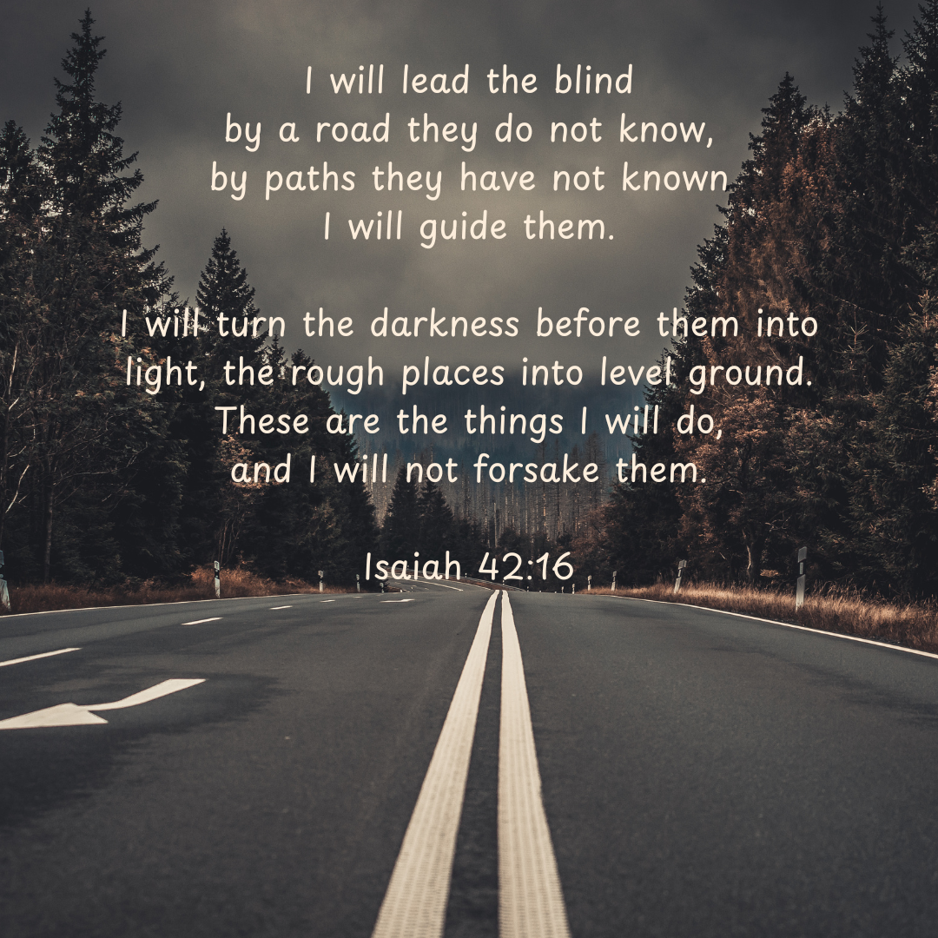
“I love that the Bible at some points takes on the social model of disability – talking about paths being made even so that people do not stumble.”
- Fern

Slide 18
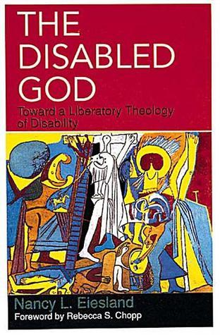
Disability Liberation Theology
Nancy L. Eiesland
The Disabled God: Towards a Liberatory Theology of Disability
Amy Kenny
My Body is Not a Prayer Request: Disability Justice in the Church
Julia Watts Belser
Loving Our Own Bones: Rethinking Disability in an Ableist World
Lamar Hardwick
How Ableism Fuels Racism: Dismantling the Hierarchy of Bodies in the Church
Hannah Lewis
Deaf Liberation Theology

Slide 19
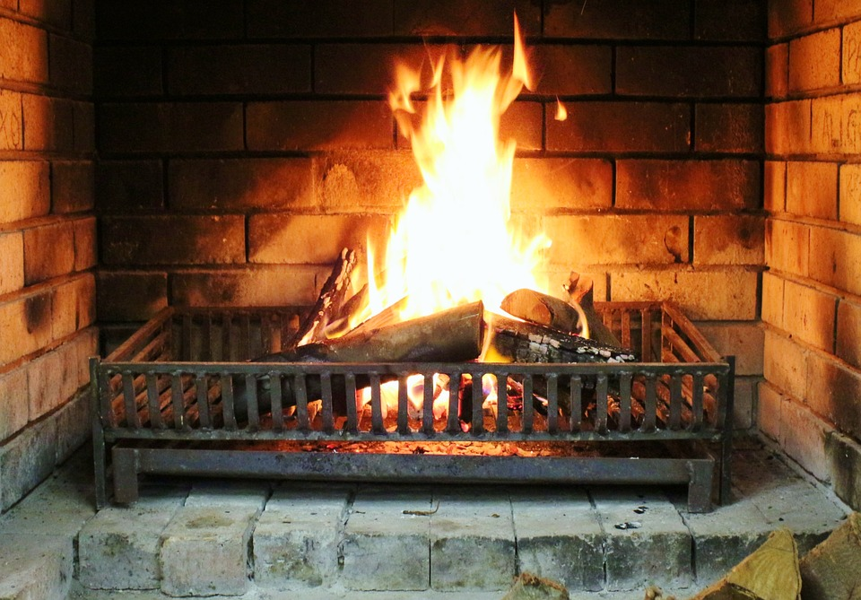
Fireside Chat
What questions came up for you, as you were reading
the chapters from At the Gates or listening to Naomi today?
What has surprised you in At the Gates or your other
reading about disability?
In society’s debates about disability, who should get to speak?
Why does it matter that we imagine God differently from the expected ways?
How does it make you feel to read disability theology and stories about disabled people? [Especially if you are a disabled or neurodivergent person]
How is your idea of disability changing as you are thinking about this subject?

Slide 20
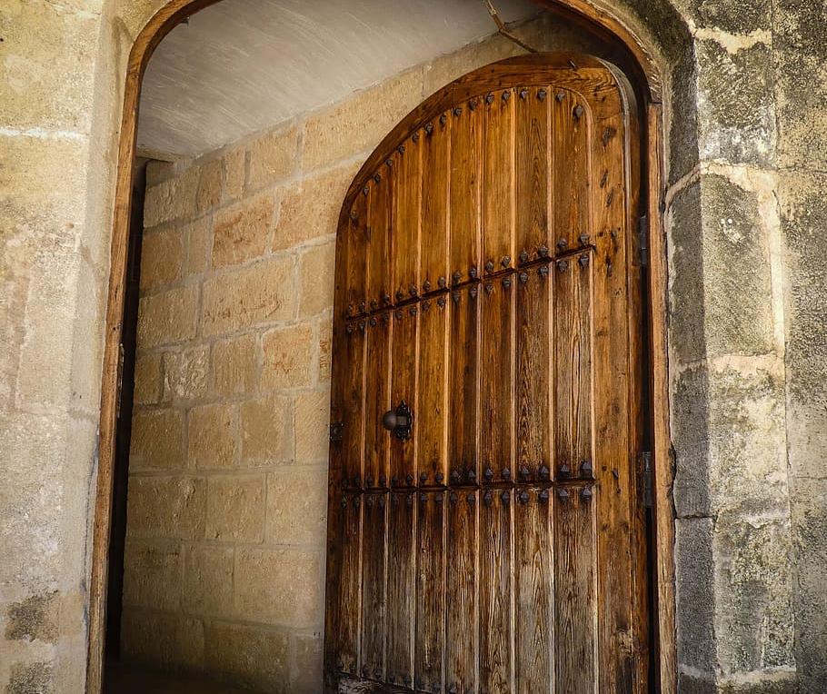
Thank you!
Find me at:
@naomijacobs.bsky.social
naomi@bantrybridge.com
naomilawsonjacobs.com

Slide 21
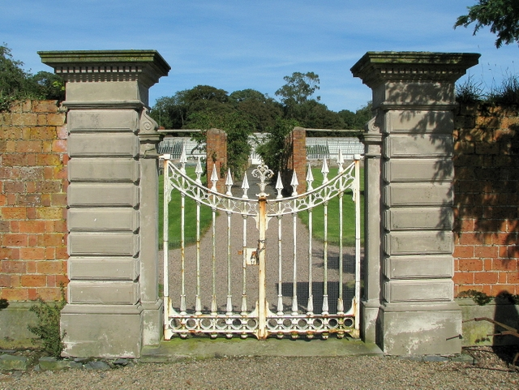
“My experiences of Christian events have mostly been bad. Access is a total afterthought!” - Jemma “It was a long time before my church began to make access really easy.” - Jane
Access and Power
Think about the places you spend your time – college, stores, restaurants, bars, religious spaces…
Is there “grace in a place” for disabled people there? (Walker, 2014)
Access is about power, privilege and justice. Churches decide whether to open their gates to disabled people.
Book recommendation:
Tanya Titchkosky, The Question of Access: Disability, Space, Meaning (2011)
Notes:
Access is about power, privilege and (in)justice. Churches decide whether to open their gates to disabled people.
Buildings limit our imagination of who is ‘in’ and ‘out’ in of a community
Is there “grace in a place” for disabled people in your church? (Mike Walker, 2014)
Are we imagined and expected among the congregation – not just invited, but enabled to come in and participate? Many churches offer a rhetorical welcome to disabled people – a welcome in words. But when disabled people arrive at the gates, we often ask for an EMBODIED WELCOME. And that can mean change. Often, that change is not expensive. But it does involve imagining disabled people among the congregation and leadership, sharing power with disabled people.
- Partial participants:
. In ‘At the Gates’ we write about how our storytellers couldn’t fit in church environments, so they were segregated to the side or the back, where they would not ‘spoil’ worship for non-disabled people. Other people were offered second-rate access, through the literal back doors and back alleys of churches, giving them the message that they were second-class members of churches. Poor access made them partial participants. But equal access is a sign of a church’s LOVE for disabled people.
The struggle to ask for our access needs to be met
Psycho-emotional disablism
Structural exclusion [define]
But even though structural exclusion is often unintentional, in churches that do not give enough thought to accessibility, disabled people still find ourselves pushed to the edge. The impact happens regardless of intention

Slide 22
The healing power of a God who is like us, with us, for us…
“The journey away from being apologetic about one’s disability is described by some as a conversion experience. Michelle Mason, a disability activist, writes, ’The day I threw away the holy water from Lourdres and said to Jesus, I think they are missing the point, was the day I joined the movement’. [She] began to look at society instead of her body as the problem.”
- Doreen Freeman, A Feminist Theology of Disability (2002)

