Slide 1
weaving together so many unheard stories
Activist research to resource a disabled Christian movement
Naomi Lawson Jacobs
University of Leeds
n.l.jacobs@leeds.ac.uk

Slide 2
research SILENCING DISABLED PEOPLE
Academics [researching disability]… have cast themselves in the role of expert and ‘knower’ – a role which… maintains that the knowledge and experience of disabled people does not count.
Stone & Priestley, 1996
Epistemic injustice (Fricker 2007)
Notes:
Disabled people's lived experience has not been a source of accepted (academic) knowledge about us
Epistemic authority about disabled people is held by professionals – medical professionals, research professionals, and (as I’ll come to in a minute) ministers of religion & theologians
Miranda Fricker: epistemic injustice
Lived experiences of embodiment not considered a source of knowledge

Slide 3
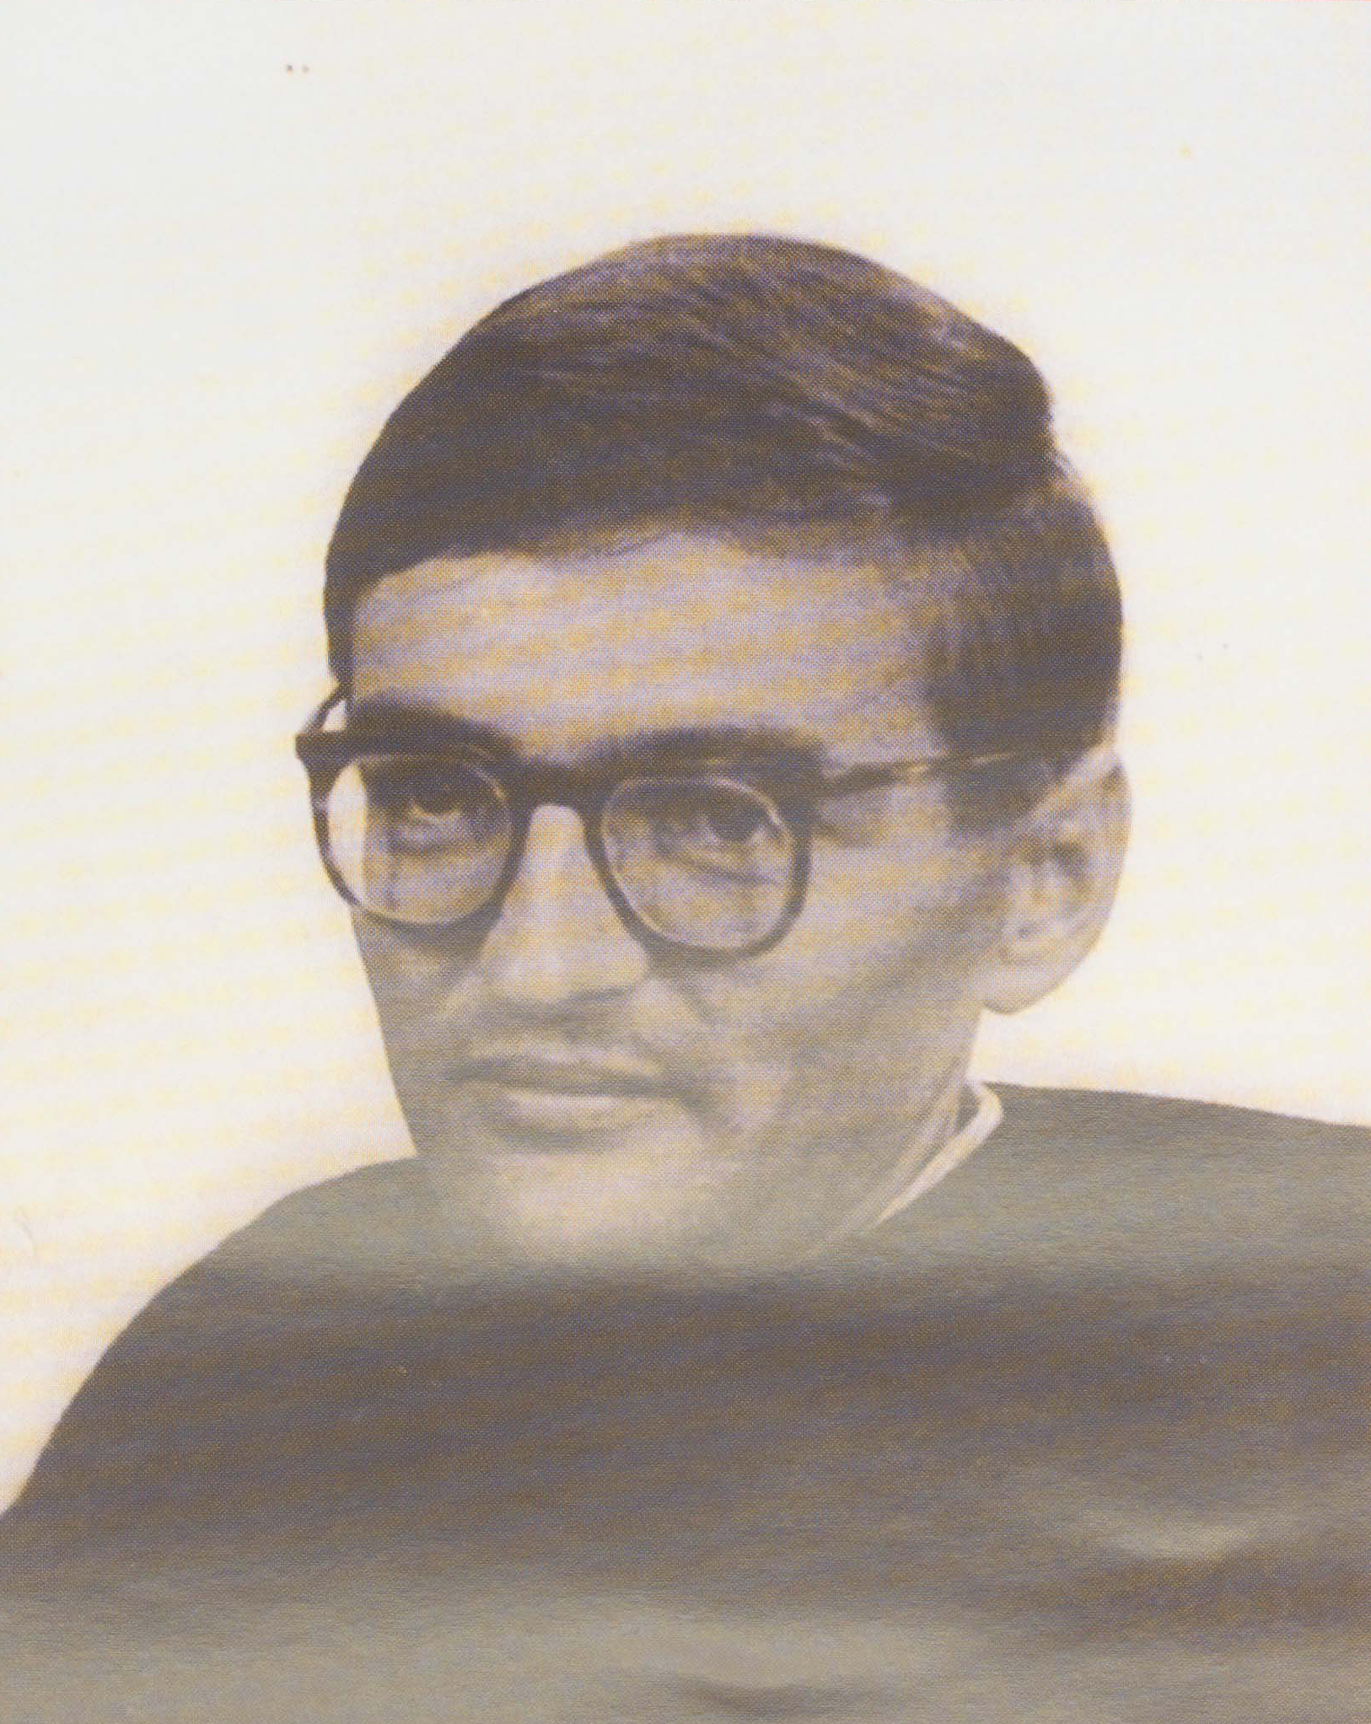
Oppressive social research on disability
Faced with any socially oppressed group, social scientists have a choice of only two alternatives: either a firm commitment to serve the interests of the oppressed group to end their oppression, or a commitment to serve the interests of the oppressors to continue their oppressive practices (which last they also do by serving their own interests). There can be no middle way.
Hunt, 1981
Paul Hunt
Notes:
- Whose side are we on? - Howard Becker (1970s) – Hunt was among the first people to write about this in relation to disability research – but he wasn’t a researcher, he was a disabled activist

Slide 4
Activism & Gatecrashing knowledge
Activism and research can inform each other to transform ableist structures (Gillberg 2020:16)
Emancipatory disability research
Gatecrashing: “a methodological revolution… we need knowledge built on disability as the norm” (Gillberg 2020:26).
What (and who) is academic knowledge for?
How far can disability research be a resource for activism, in contexts where there is little activism?
Notes:
(Gillberg, 2020)
Activism: “concerted efforts to change the status quo based on jointly identified barriers that render parity of participation and full social citizenship difficult or impossible” (16).
Gatecrashing knowledge: “a methodological revolution… we need knowledge built on disability as the norm” (26)
Systemic change ← methods & criteria that value disabled knowledge
Activism and research can inform each other to transform ableist speople’s (experiential) tructures
My questions arising from Gillberg’s (& others’) work:
What (and whom) is academic knowledge for?
How far can disability research be a resource for activism?

Slide 5
PhD research – Disabled Christians’ experiences in UK churches
Study of Religions, SOAS (2019)
Supervisor: Sian Hawthorne
The Research
30 qualitative interviews with disabled Christians
Participation observation in disabled-led church groups
Second stage of research for a book
Accessible & participatory methods
Reciprocity
Sampling
Disability: self-definition
- Physical impairments
- Long-term illnesses
- Neurodivergent participants
Range of church backgrounds Aged between 23 and 82
Social & political-relational frameworks (Kafer, 2013)

Slide 6
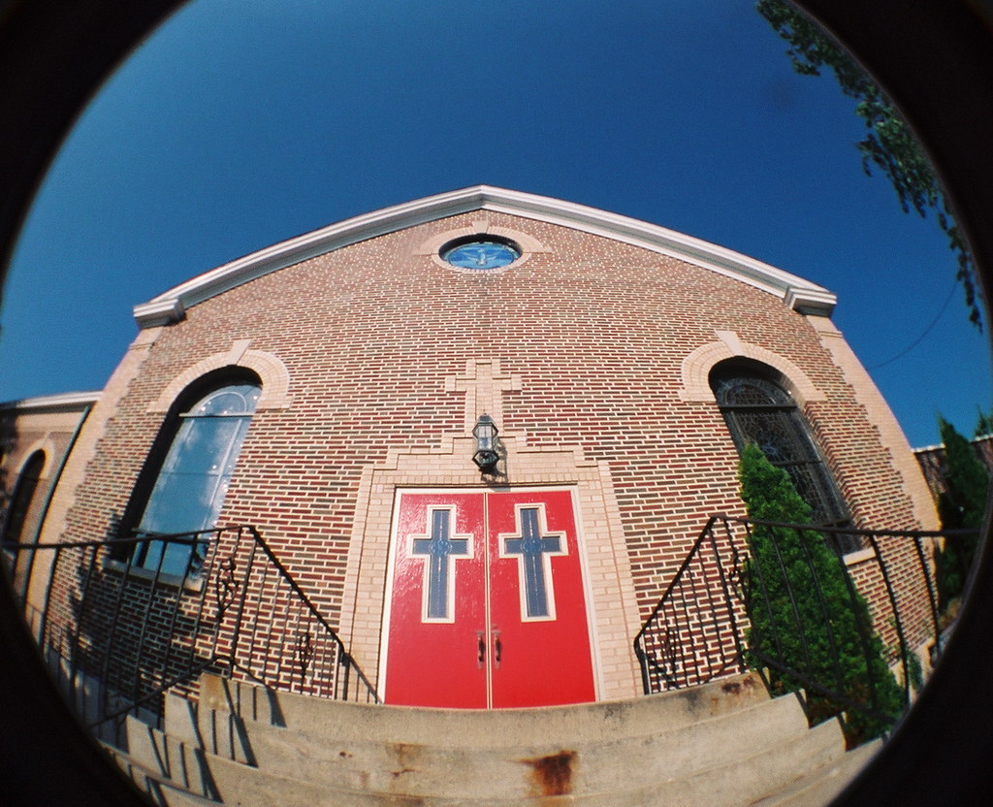
Disabled people & churches: the context
So much of the time the voices heard on disability – particularly in the church – are non-disabled people who speak from study or research… It is from the centre looking out, rather than from the edge… If it is the only voice, it can do damage.
Fiona MacMillan & Samuel Wells, 2021
Gap in research – disabled people in religious communities (Creamer 2006, Imhoff 2017)
Pastoral power in churches (Foucault 1982)
Disabled people as knowers & theologians
Notes:
Disabled Christian Fiona MacMillan writes that disabled people have been seen in the churches as “objects for pastoral attention” rather than “agents for change.”
Gap in research on religion in disability studies (Creamer, Lewis)
Theology by non-disabled people, about disability
Disabled people’s embodied perspectives often missing from the theology about us
This context of epistemic injustice led me to start to theorise about one thing and conceptualize another:
Pastoral power in churches (foucaldian terms)
There was a sense of silence and silencing around disability and churches
Disabled people as knowers & theologians
How could my research not just avoid harm, of the kind that MacMillan is talking about here, but be a benefit to disabled Christians and their activism in resistance against epistemic injustice in their churches? Especially when disabled people in this context were so disempowered, with no disabled-led activist movement to speak of in churches when I began this research, and silencing and silence in theology. Very little research in sociology of religion or religious studies. No research in disability studies. Few disabled Christians’ stories were being heard.
- RECIPROCITY in research became important to my work

Slide 7
BRIANNA: Activism in the pews
At big services I’m constantly seeing [disabled] people arriving with nowhere to go, and the seats already filled up.…[The stewards] have to ask, “Would you please go and sit elsewhere?” This poor person in the wheelchair is going, “I’m so sorry, I’m so sorry to cause this fuss and I’m so sorry…” Now, since then, I have witnessed other people go through that same hideous ordeal… But when I say, “There should be spaces left for wheelchairs,” they think that what I’m asking is… a seat reserved for me every service… They can’t look at the wider picture.
…[M]aybe I should just give up on the cathedral and go to the local church… But I have this fight… I try very hard to do it through education, through talking, through… creating a cause… But I have cried bucket loads over it, because I do feel completely invisible and violated.
Notes:
When I started this research, no disability movement to speak of in the churches, other than a few engaged individuals. And they had very few resources for activism or fighting for change. They weren't hearing the stories of other disabled people, so many felt very isolated, and they often weren't able to access theology about themselves or participate in that conversation.
Participants were engaging in activism for transformation of churches in the face of epistemic injustice.
Let me tell you about just two examples.
Brianna… quote…
"Selfish & needy"
Forcibly moved and kicked in her wheelchair
Told she was ‘in the way’
Self-policed her affective responses

Slide 8
Jemma: disability theology as resistance
…I have limited knowledge [about disability and the Bible], but I have found myself trying to explain complex issues to those in leadership… I often feel misunderstood or struggle to understand how teachings apply to me.
…It’s hard to find material about disability and theology that is actually written by disabled people. Many, many books are written about disabled people and the church, but our own voices are not heard.
Notes:
Jemma is blind and neurodivergent, and she attends an unaffiliated evangelical church. She participated through writing and email exchanges.
Jemma was taking theology courses – they weren’t particularly accessible to her, but she was ploughing on, because she wanted to contribute to the theological conversation on disability. That’s what she felt would lead to change.

Slide 9
Participants’ resistance & activism for change
Often lacked spiritual capital needed to participate in the theological conversation
Were often aware of gaps in critical research on disability and religion
Rarely able to find theology and teaching that reflected their lived experience
Isolated – were looking for an imagined community (Garland-Thomson 1997)
stories of other disabled Christians
Were engaging in activism & resistance and sharing lived theology
individually
(increasingly) in collective activism
Notes:
Participants
Were often aware of gaps in critical research on disability and religion
…and the dominance of non-disabled perspectives in theology of disability
Had rarely been able to find theology and teaching that reflected their lived experience – stories that centred disabled Christian voices
Often lacked the spiritual (and other) capital to participate in the theological conversation
Were engaging in activism, resistance & lived theology, individually and (especially later) in groups
(Some were very isolated – one talked about being “the only one” in her situation – these participants often seeking what RGT calls an “imagined community” of other disabled people, through reading stories like theirs in books and hearing them in teaching in churches.)

Slide 10
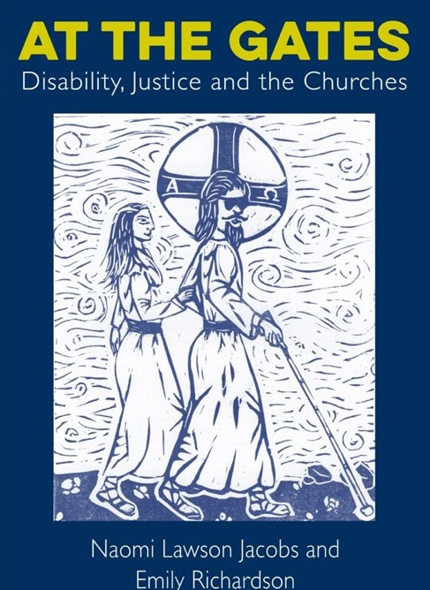
Research as a resource for activism
Book co-written with participant, as a resource
Research to benefit disabled Christians
Second stage of narrative research
From participants to storytellers
Citational politics (Ahmed, 2017)
Working with a community
A research ethic of reciprocity
Opportunities for more accessible knowledge exchange

Slide 11
‘At the Gates’ Book Launch
Notes:
Transcript – Jemma Brown speaking at the book launch of ‘At the Gates’:
“My message, really, is to follow the guide of disabled people, because we are normally the experts in our own experience, and to listen to us. And make it a real priority to dismantle barriers that are put in place by the church, that make it harder for disabled people to be in that space. Normalize ramps. Having large print and hearing loops, materials. And quiet areas for neurodivergence – I love a quiet area. But also take it further, and commit to change attitudes that see disabled people pastorally in recipient of care roles by the church. And empower disabled people into leadership roles. And similar to Kt, I would love to buy so many of the church leaders I know a copy of this book, and I wish I could.”

Slide 12
‘IMPACT’ and activist research
“I was the sole disabled person in my story but I'm suddenly aware that there are many of us. I'm not alone! I can't tell you how much that means to me.”
“Reading the passages that referred to me was transformative. It gave me strength to tackle [access at my church] one more time... It's really tiring to keep challenging institutions... The struggle goes on! You have given a whole community support by vocalising our issues.”
- Storytellers’ feedback
Notes:
Silence & silencing… how far are we complicit, as researchers? And how far are we amplifying the voices of those we do research with, through non-exploitative research that benefits them? Whose side are we on?

Slide 13
WEAVING TOGETHER UNHEARD STORIES
"As co-author I sometimes say I came late to the formation of this book, when Naomi’s research was almost ready to be shared. But I then remember sitting around a table with other research participants, as I shared my experiences and listened to theirs, and I realise that this book has been a lifetime’s work. As I have wrestled to work out my place within a church that sometimes dismisses or devalues me, I have met so many other pilgrims along the way. In writing this book, I have been reminded that I am writing not only my story, not only Naomi’s story, but weaving together so many unheard stories." Emily Richardson, 2022
Notes:
So let me end with Emily's voice and her response to the book and research. In the book, she wrote: "As co-author I sometimes say I came late to the formation of this book, when Naomi’s research was almost ready to be shared. But I then remember sitting around a table with other research participants, as I shared my experiences and listened to theirs, and I realise that this book has been a lifetime’s work. As I have wrestled to work out my place within a church that sometimes dismisses or devalues me, I have met so many other pilgrims along the way. In writing this book, I have been reminded that I am writing not only my story, not only Naomi’s story, but weaving together so many unheard stories."

Slide 14
references
Fricker, M. (2007). Epistemic Injustice: Power and the Ethics of Knowing. Oxford: Oxford University Press.
Garland-Thomson, R. (1997). Extraordinary Bodies: Figuring Disability in American Culture and Literature. New York & Chichester: Columbia University Press.
Gillberg, C. (2020). ‘The Significance of Crashing Past Gatekeepers of Knowledge: Towards Full Participation of Disabled Scholars in Ableist Academic Structures." Ableism in Academia: Theorising Experiences of Disabilities and Chronic Illnesses in Higher Education; Brown, N., Leigh, J., Eds (2020): .’ In: Brown, N. & Leigh, J. (eds.) Ableism in Academia: Theorising Experiences of Disabilities and Chronic IIlnesses in Higher Education. eBook ed. London: UCL Press.
Hunt, P. (1981). ‘Settling Accounts with the Parasite People.’ Disability Challenge, 1, 37-50.
Jacobs, N. L. & Richardson, E. (2022). At the Gates: Disability, Justice and the Churches. London: Darton, Longman & Todd.
Stone, E. & Priestley, M. (1996). ‘Parasites, Pawns and Partners: Disability Research and the Role of Non-Disabled Researchers.’ British Journal of Sociology, 47, 699-716.

Slide 15
weaving together so many unheard stories
Activist research to resource a disabled Christian movement
Naomi Lawson Jacobs
University of Leeds
n.l.jacobs@leeds.ac.uk

