Slide 1
ADHD and Spiritual Wandering:
Walking Labyrinths, Re-membering Embodied Christian Practice
Naomi Lawson Jacobs, University of Leeds
naomi@bantrybridge.com

Slide 2
ADHD and Spiritual Wandering: Walking Labyrinths, Re-membering Embodied Christian Practice
Sit Still, Pay Attention – ADHD and my experience of liturgy
Wandering – walking labyrinths as embodied (ADHD) spiritual practice
Neuroqueering spiritual practice – inspiration from thinkers who challenge the norms of Christian spiritual practice

Slide 3
My Positionality & Method
AuDHDer (ADHD ‘inattentive type’)
Christian and Pagan
Late diagnosis of ADHD
—> counter-narrate my ADHD experiences in Christian worship
(Bertilsdotter Rosqvist et al 2023)
Autotheory (Fournier 2022, Lorde 1982)
Notes:
[1 min]
AuDHDer (both autistic & have ADHD)
Diagnosed autistic in my early 30s
Diagnosed with ADHD age 40
Christian, Pagan & accidental theologian - not good at going to church
Research with disabled Christians (Jacobs 2019; Jacobs & Richardson 2022)
Significant number of autistic participants – far fewer ADHDer participants
Diagnosis of ADHD —> counter-narrate my story as a practitioner of religion(s) – retell my story not as a representation of my ‘failure at church,’ but in ways that embrace my ADHD self and the forms of worship that work for me.
Where are the ADHDers in Christian theology & churches? (Original title of my talk was ‘ADHDers are Here’ – you will see why it has changed…)

Slide 4
ADHDers are Where?
ADHD is missing from theology
Lots of theology of autism (by non-autistic people)
Largely silent on ADHD (Barclay 2008; Jacobs 2022)
One of many areas of disability theory where ADHD is ‘missing’
Bertilsdotter Rosqvist et al 2023; Eric Olund 2024
Broader tendency in disability studies to disengage from religion
Creamer 2006; Imhoff 2017; Lewis 2007

Slide 5
Liturgy: Sit Still, Pay Attention
Central structure of worship in Anglican and other (liturgical) churches
“public work” – public ritual – based on spoken/sung led prayer
Theory & Theology of Liturgy
Order: liturgy is the ordering of religious experience
Embodied experience
Full, sensory engagement in liturgy – a moral imperative for Christians? (Pickstock 2019)
Time: distinction between ordinary time and liturgical time/sacred time
Eternal time, “time out of time” (Rappaport 1992)
Liturgy encourages “right relationship with time” (Quash 2002)
Notes:
I am a member of the Anglican church and I like the Anglican church, even though it has many flaws. I really enjoy receiving communion and the theology of why it’s important. But I struggle with the liturgy of the Anglican church.
Eternal time – ecstatic time

Slide 6
An ADHDer and Liturgy: Sit Still, Pay Attention
The Eucharistic Prayer
Notes:
[VERY BRIEFLY!]

Slide 7
The Eucharistic Prayer

Slide 8
An ADHDer ‘failing’ at liturgy
Attempting to discipline my wandering (inattentive) mind
Time stretches on forever
Painful to fight inattention
Holy fidget toys…
Unmasked & noticed – disruption (Jacobs 2019)
Not an “ideal worshipper” (Jacobs 2019)
An “impossible subject” (Waldock, 2023)
“I did not meet the norms of being able to worship in such a space, or at least not without physically removing myself and not advocating for my needs” (Waldock, 2023, p. 11).
“Neurodivergent bodies and brains mediate how we belong through challenging norms and others’ standards, leading to some of us becoming ‘impossible subjects’” (Waldock, 2023, p. 12).
Notes:
Theoretically, the worst that happens to me when I’m unmasked is disapproval. But this is disapproval in a context of Christian theology that says I should be engaging in liturgy *properly* or I’m not honouring God enough (this is something my research participants talked about – you have to behave appropriately in sacramental settings or you are dishonouring God). The stigma that results is not just about how I behave in liturgy – there are negative reactions to me in all contexts in church – this is just one, but it’s an important one. And I fail at it. (A few of my autistic research participants talked about the soothing quality of regularized ritual – I used to relate to that more, from an autistic perspective,

Slide 9
ADHD, embodiment and time
ADHD – a different way of being embodied in the world
Cameron 2024; Levin 2017; Maiese 2012
ADHD – a different experience of time
A desynchronised way of being in the world (Nielsen, 2017)
Mind-meandering (Attias 2020)
“…letting go of neuronormative time… Time is elliptical… the disorganized and messy processing of emotions and experiences to generate new understanding of events” (Attias 2020:66).
Sharma (2024) – clock time vs event time – time perception has a cultural context
Crip time (Samuels 2017, Kafer 2013)
Resisting chrononormativity
Notes:
ADHD – a different way of being embodied in the world
Cameron 2024; Levin 2017; Maiese 2012
ADHD – a different experience of time (almost no research on ADHD & time but there is a little emerging…)
A desynchronised way of being in the world – out of time (Nielsen, 2017)
Mind-meandering (Attias 2020)
“…letting go of neuronormative time and being idle with one’s thoughts. Time is elliptical… the disorganized and messy processing of emotions and experiences to generate new understanding of events” (Attias 2020:66).
Context for these theories is the global north - Ramona Sharma (2024) - time perception is cultural - different in communities in Global South vs North
Crip time (Samuels 2017, Kafer 2013)
“Rather than bend disabled bodies and minds to meet the clock, crip time bends the clock to meet disabled bodies and minds” (Kafer 2013:27)

Slide 10
Peregrinatio
Exile/Wandering for the Love of the Divine

Slide 11
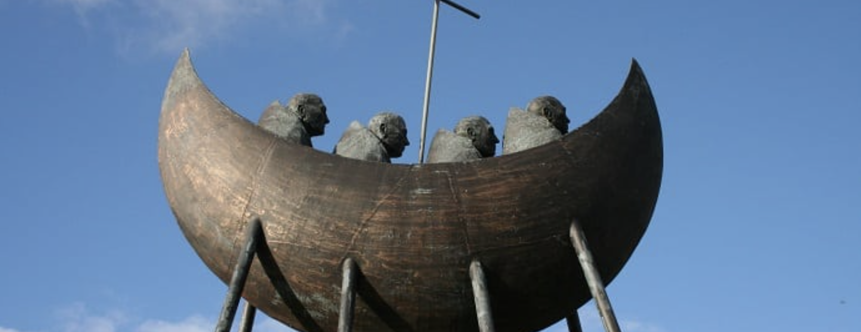
St Brendan the Navigator
Statue of St Brendan’s boat, Tralee, Co. Kerry, Ireland

Slide 12
Labyrinths: Wandering out of the Church
Classical labyrinth at Brock University, Ontario (built 2019)

Slide 13
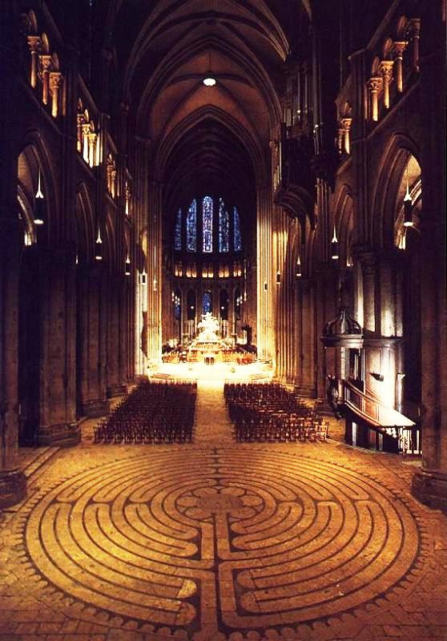
Labyrinth-walking: Ancient practice?
3000 years – Europe & North Africa
Medieval labyrinths – intricate designs
Metaphor for salvation? Pilgrimage?
No evidence they were walked as a spiritual practice…
c. 1980s – labyrinth revival (Christians, Neo-Pagans)
Wandering; getting lost without getting lost
Chartres Cathedral labyrinth (13th Century)

Slide 14
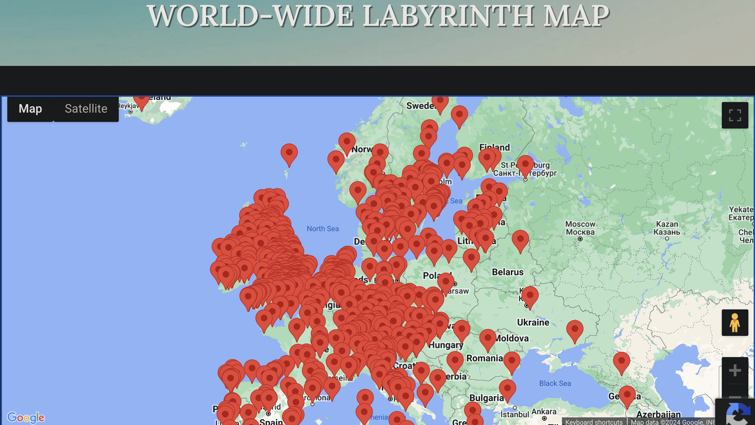

Slide 15
Outside St Peter’s Church, Addingham, West Yorkshire

Slide 16
Chiltern Park Woodland Burial Ground, Buckinghamshire

Slide 17
Hackney West Recreation Ground, North London

Slide 19
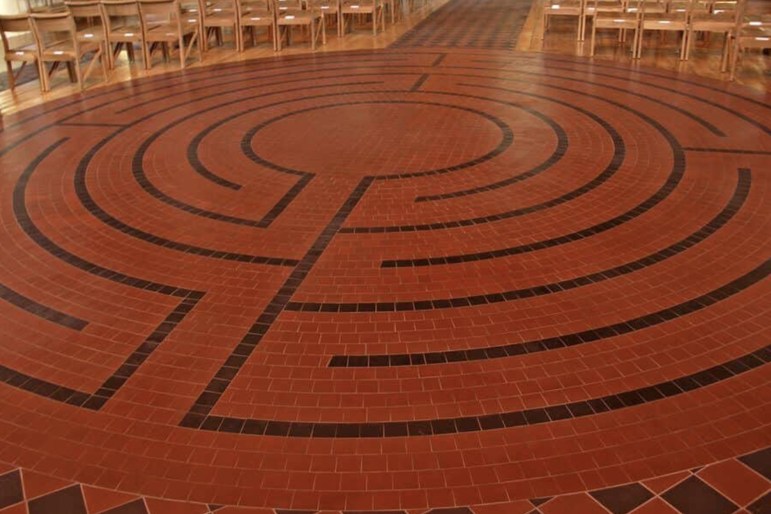
Locked church doors
St Michael & All Angels, Abingdon

Slide 20
Reflection
As I wander, my mind wanders. I re-narrate the experience of ‘spacing out’ into an experience of mind-meandering. I am expected to wander and meander in a labyrinth, both following meandering paths and wandering in my mind. Sometimes I wander to holy thoughts – snatches of prayers that come back to me – I say parts of St Patrick’s Breastplate at the corners and centre, wandering in and out of liturgy. And sometimes my mind wanders to mundane things – last night’s episode of Star Trek, the condition of my sick cat, and the vital philosophical question of whether I turned on the dehumidifier when I hung out the laundry. And all these thoughts too are holy, because the divine is in all things. As I walk, time stretches and flows and the past and the present become tangled and untangled and this is how time should feel when I’m walking a labyrinth. I’d like to say I’d like to say I’m no longer failing at time - but maybe I’m neuroqueering time, embracing ADHD time. I’d like to say I’m no longer failing at liturgy – but what if I’m embracing the ADHD art of failure - failing at linear liturgy, embracing the non-linear Christian traditions of contemplative prayer? I’d to say I’m no longer failing at embodiment, but I’ve tripped and fallen down in so many labyrinths at this point that I don’t think I’m succeeding at embodiment, but when I walk a labyrinth I am re-membering my embodiment – I am re-membering myself in the Body of Christ. My ADHD embodiment is holy.
Notes:
As I wander, my mind wanders. I re-narrate the experience of ‘spacing out’ into an experience of mind-meandering. I am expected to wander and meander in a labyrinth, both following meandering paths and wandering in my mind. Sometimes I wander to holy thoughts – snatches of prayers that come back to me – I say parts of St Patrick’s Breastplate at the corners and centre, wandering in and out of liturgy. And sometimes my mind wanders to mundane things – last night’s episode of Star Trek, the condition of my sick cat, and the vital philosophical question of whether I turned on the dehumidifier when I hung out the laundry. And all these thoughts too are holy, because the divine is in all things. As I walk, time stretches and flows and the past and the present become tangled and untangled and this is how time should feel when I’m walking a labyrinth. I’d like to say I’d like to say I’m no longer failing at time - but maybe I’m neuroqueering time, embracing ADHD time. I’d like to say I’m no longer failing at liturgy – but what if I’m embracing the ADHD art of failure - failing at linear liturgy, embracing the non-linear Christian traditions of contemplative prayer? I’d to say I’m no longer failing at embodiment, but I’ve tripped and fallen down in so many labyrinths at this point that I don’t think I’m succeeding at embodiment, but when I walk a labyrinth I am re-membering my embodiment – I am re-membering myself in the Body of Christ. My ADHD embodiment is holy.

Slide 21
Wandering: Neuroqueering Spiritual Practice?
Experiencing peregrinatio (a journey without a destination)…
…as meandering (Attias 2020)
Re-narrating inattention as spiritual wandering
“Wandering cannot hold onto a center; its primary aim is to defy aim… Why is an author ‘intentional’? Why is an autistic child ‘nonintentional’?”
(Yergeau, 2018)
Notes:
Wandering – a spiritual practice that could make space for ADHD embodiment
(Neuroqueering – Nick Walker)

Slide 22
Christian traditions resisting theological normalcy (Crip theologies, queer theologies, Black theologies…)
Trans/Criptions – Max Thornton
“Rather than apologizing for, correcting, or eliminating the wasted time of trans/crip experience… we might consecrate this wasted time, this uselessness, these ruptures in the fabric of capitalism… [a] conscious performing of the liturgies of being trans/crip to resist the scripts of capitalist chrononormativity.”
Taking medication, attending physiotherapy
Strapping on prostheses
Waiting for wheelchair lifts
(Stimming and spacing out and wandering)
“…the sacralizing of trans/crip experience opens a space for change in the daily lives of trans and disabled people” (Thornton 2o19:365)

Slide 23
Black Theology and the Contemplative Christian Tradition Not Sitting Still
“To suggest a form of faith that tells me to sit down alone and be quiet? It does not rest easy on the bones. It is a shadow of true contemplative life, and it would do violence to my Black-­woman soul.”
“For me, most simply, contemplative spirituality is a fidelity to beholding the divine in all things…. A sacred attention. And as we pay attention, we make a home out of paradox, not just in what we believe but also in the very act of living itself. Stillness that we would move. Silence that we would speak.”
Cole Arthur Riley, ‘This Here Flesh’ (2022, emphases mine)
And perhaps… not paying attention, that we would pay attention (to the divine)?
Notes:
If Cole Arthur Riley would permit me, I would like to use her method of paradox and expand it for my purposes. I would like to add… “not paying attention, that I would pay attention to the divine” to her list of paradoxes. When I am walking a labyrinth I am embodying sacred attention. I have learned from Black theologians like Cole Arthur Riley that contemplation does not have to look like white supremacist heteropatriarchal theologies say it does - my practices do not have to look like Christian theological normalcy. My ADHD-affirmative, embodied practices are a challenge to theologies that say that only liturgical practices are true Christian worship [REF article that says so…] – that only by saying the Eucharistic prayer can I be part of the Body of Christ. Here, walking the labyrinths, literally outside the churches – even when the church doors are locked to me – I am re-membering my ADHD self.

Slide 24
The queer art of (liturgical) failure
“…it is only by speaking wrongly, through failure, that God emerges in the world... When have you known theology to speak wrongly, especially in and through Christian worship? What has that revealed to you about humanity, creation and the Holy?”
(Fennema 2023:238, my emphasis)
Liturgy should “seek to let its order constantly be broken open to matters that are far beyond its ordering ability. Such a liturgy means to reorient local practice and local perceptions of world so as to invite us again and again to walk in this world in the way of faith, not control. Indeed, such a liturgy invites us to the active criticism of both the religion and the politics of control.”
(Cones 2023:35)

Slide 25
ADHDers Are Here?
Not ‘there’ – unless I can sit still, pay attention
Normative spiritual practice inside (locked) churches
Peregrinatio outside the churches – exile without return
Do I want to wander back?
‘Believing without belonging’ (Davie, 1994)
Spirituality on the edge & disabled people (Jacobs & Richardson 2022)
Is labyrinth-walking liturgy?
A church that celebrates ADHD bodyminds & forms of worship
…that is not threatened by ‘impossible subjects’ – including ADHDers
…that welcomes trans/cription, disruption, crip and neuro/queer time

Slide 26
Naomi Lawson Jacobs, University of Leeds
naomi@bantrybridge.com
https://linktr.ee/naomilawsonjacobs

